Slide 1
C# -COLLECTIONS & LINQ
By,
Nisha paul

Slide 2
OVERVIEW
Limitations of an array
What are collections
Generic Collections
Non-Generic Collections
LINQ

Slide 3
Limitations of an array
The array size is fixed.
We can never insert an element into the middle of an array
Its not easy to delete or remove elements from the middle of the array.
Arrays doesn’t provide any built-in methods

Slide 4
COLLECTIONS
Collections are classes that provide an easy way to work with a group of objects.
Like an array, a collection can also be used to store objects.
The stored object can grow or shrink dynamically.
We can insert an element into the middle of a collection.
It also provides the facility to remove or delete elements from the middle of a collection.
Collections are classified into 4 types such as Indexed Based, Key-Value Pair, Prioritized Collection, and Specialized Collections.

Slide 5
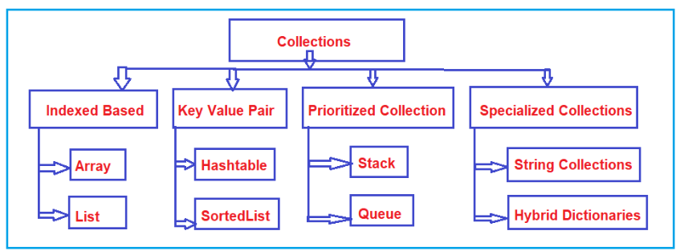
COLLECTIONS

Slide 6
Based on type safety, thread safety, mutability, and purpose, there are four types of namespaces.
System.Collections
System.Collections.Generic
System.Collections.Concurrent
System.Collections.Immutable

Slide 7
GENERIC COLLECTIONS

Slide 8
GENERIC COLLECTIONS
Defined under the System.Collection.Generic namespace.
It provides a generic implementation of standard data structure like linked lists, stacks, queues, and dictionaries.
These collections are type-safe and can hold objects of specific type.
Type has to be specified at the time of creation.

Slide 9
GENERIC COLLECTIONS
The System. Collections.Generic namespace contains the following classes:
List<T>
Stack<T>
Queue<T>
Dictionary<Tkey, Tvalue>
SortedList<Tkey, Tvalue>

Slide 10
GENERIC COLLECTIONS
List<T>
A dynamic-sized list that can hold objects of type T.
Generic equivalent of the arraylist.
Index based accessing.
Built-in functionality provides a range of methods.
Add
Remove
RemoveAt
Count
Sort
Contains
Indexof
insert

Slide 11
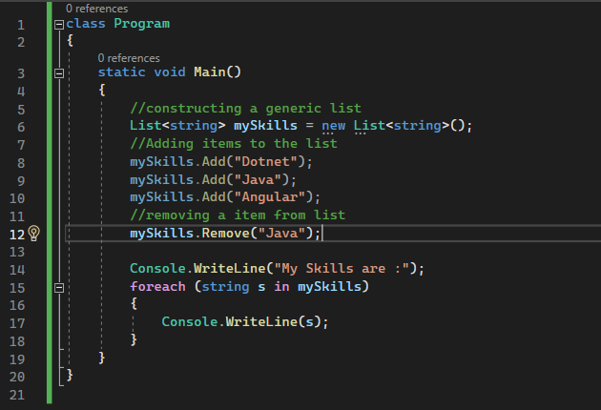

Slide 12
GENERIC COLLECTIONS
Stack<T>
Last-In, First-Out (LIFO) data structure.
Built-in functionality provides a range of methods.
Push
Pop
Peek
Count
Clear
Contains

Slide 13
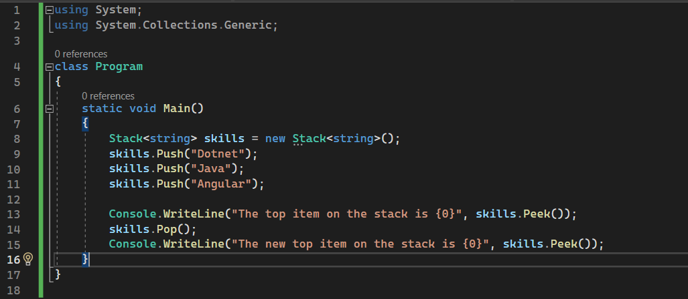

Slide 14
GENERIC COLLECTIONS
Queue<T>
First-In, First-Out (FIFO) data structure.
Built-in functionality provides a range of methods.
Enqueue
Dequeue
Peek
Count
Clear
Contains

Slide 15
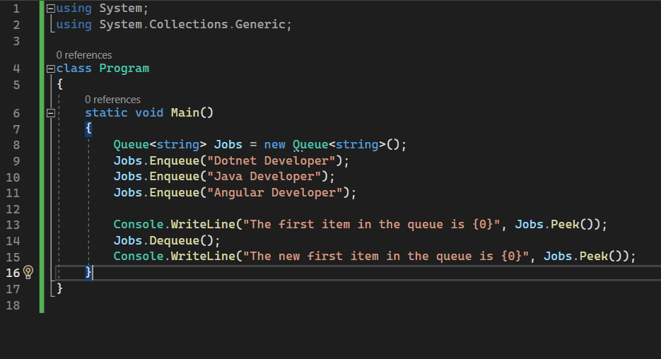

Slide 16
GENERIC COLLECTIONS
SortedList<Tkey,TValue>
Stores key/value pairs, automatically sorted by keys. .
It combines the features of both a dictionary and a sorted array.
Lookup and insertions are fast, and you can access elements by key or by index.
Built-in functionality provides a range of methods.
Add(Tkey key, Tvalue value)
Remove(Tkey key)
RemoveAt(int index)
Count
ContainsValue(Tvalue value)
ContainsKey(Tkey key)
IndexOfValue(Tvalue value)
IndexOfKey(Tkey key)

Slide 17
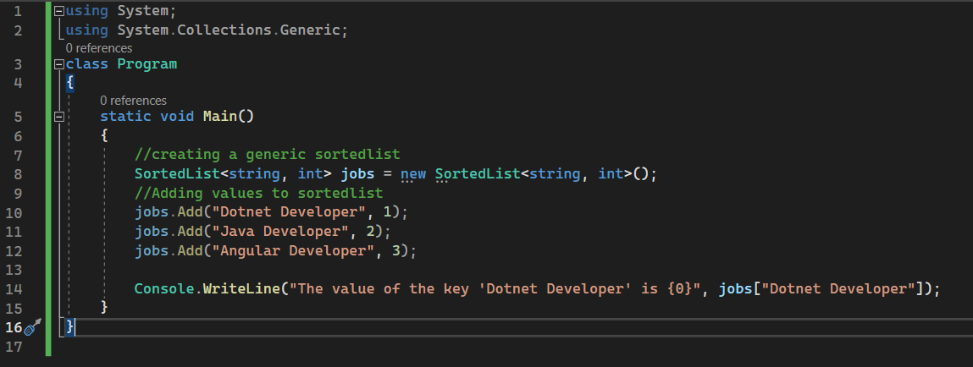

Slide 18
GENERIC COLLECTIONS
Dictionary<Tkey,TValue>
Used to store key/value pairs with fast lookups.
Implemented using a hash table.
Keys must be unique and can’ be null.
Not sorted — items are stored in arbitrary order.
Optimized for fast retrieval of values based on keys.
Built-in functionality provides a range of methods.
Add(Tkey key, Tvalue value)
Remove(Tkey key)
Count
ContainsValue(Tvalue value)
ContainsKey(Tkey key)
Clear

Slide 19
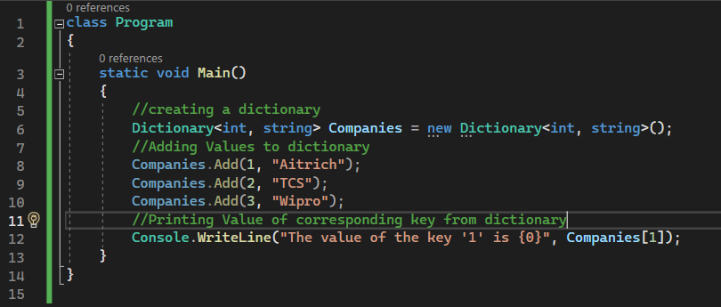

Slide 20
NON-GENERIC COLLECTIONS

Slide 21
NON-GENERIC COLLECTIONS
Defined under the System.Collections namespace.
Operate on objects, and hence can handle any type of data.
Not in a safe-type manner.
High flexibility.
No compile-time errors.

Slide 22
NON-GENERIC COLLECTIONS
The System. Collections namespace contains the following classes:
ArrayList
Hashtable
SortedList
Stack
Queue

Slide 23
NON-GENERIC COLLECTIONS
ArrayList
A dynamic array implementation that can store objects of any type.
Provides a resizable array- like data structure with automatic expansion and contraction capabilities.
Built-in functionality provides a range of methods.
Add
Remove
RemoveAt
Count
Sort
Contains
Indexof
insert

Slide 24
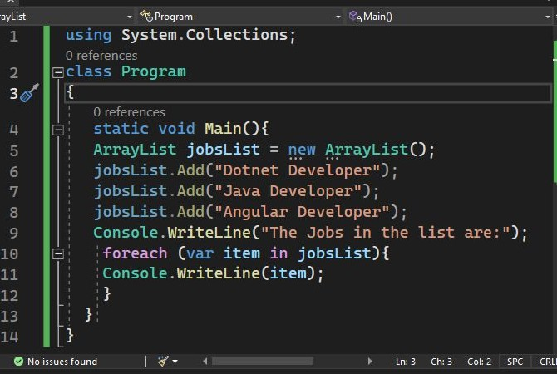

Slide 25
NON-GENERIC COLLECTIONS
Hashtable
Stores key/value pairs.
Fastest retrieval of element using hashtable algorithm which maps keys to its corresponding values.
It’s similar to Dictionary<TKey, TValue>, but it stores keys and values as object, so it lacks type safety.
No guaranteed order of keys.
Key should represent in quotes.
Key can’t be null, value can be
Key are unique and values can be of any type.

Slide 26
NON-GENERIC COLLECTIONS
Built-in functionality provides a range of methods.
Add
Remove
Contains
ContainsKey
ContainsValue
Count
Clear

Slide 27
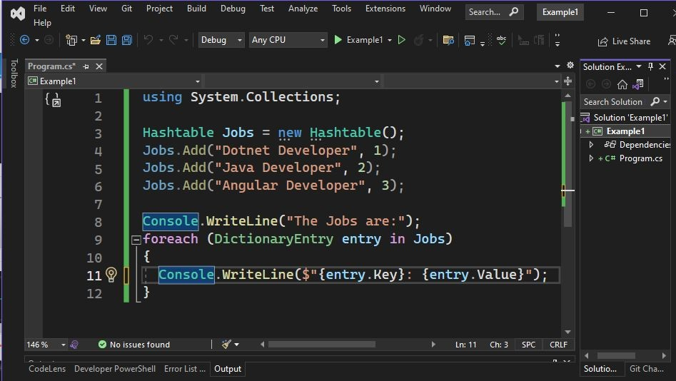

Slide 28
NON-GENERIC COLLECTIONS
SortedList
Stores key/value pairs, automatically sorted by keys in ascending order.
It combines the features of both array and hashtable.
Can access elements by key or by index.
Uses binary search algorithm to locate elements quickly.
Built-in functionality provides a range of methods.
Add
Remove
RemoveAt
ContainsValue
ContainsKey
IndexOfValue
IndexOfKey

Slide 29
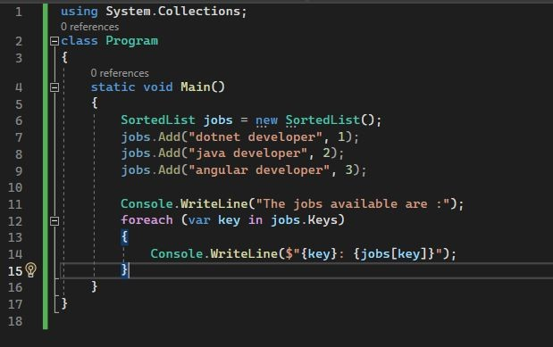
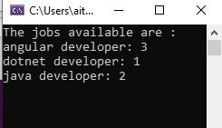

Slide 30
NON-GENERIC COLLECTIONS
Stack
Last-In, First-Out (LIFO) data structure that stores objects.
Built-in functionality provides a range of methods.
Push
Pop
Peek
Count
Clear
Contains

Slide 31
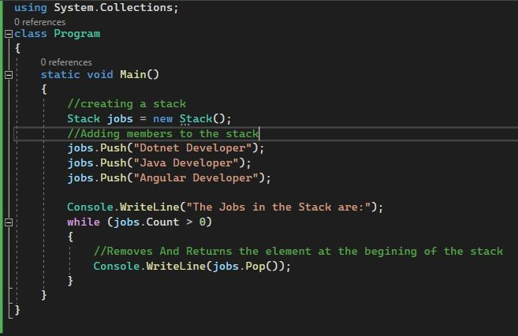

Slide 32
NON-GENERIC COLLECTIONS
Queue
First-In, First-Out (FIFO) data structure used to store objects..
Built-in functionality provides a range of methods.
Enqueue
Dequeue
Peek
Count
Clear
Contains

Slide 33

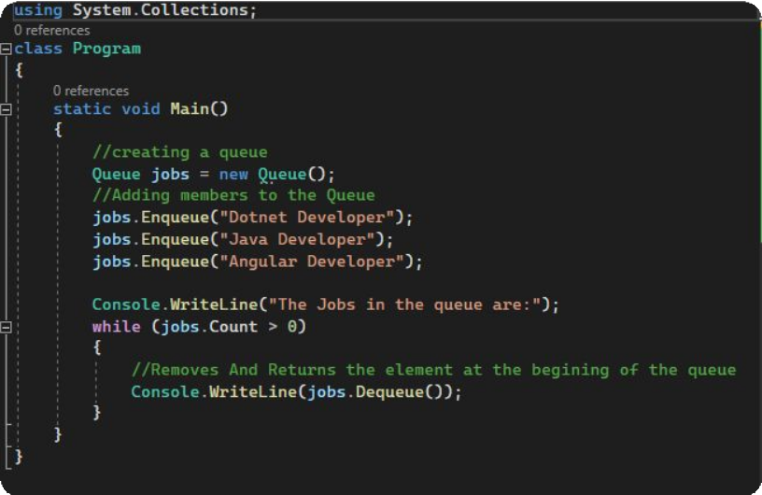

Slide 34
LINQ (Language Integrated Query)

Slide 35
LINQ
LINQ stands for Language Integrated Query.
It's a feature in .NET programming languages like C# and Visual Basic.
LINQ is present in System.Linq namespace.
It allows developers to query data from different types of data sources using a uniform syntax.
Provides a set of standard query operators that enable querying data in a declarative way on collections of objects, databases, XML documents, and other data sources directly from within their code.

Slide 36
Advantages of LINQ
User does not need to learn new query languages for a different type of data source or data format.
It increase the readability of the code.
Query can be reused.
It can be used with array or collections.
LINQ supports filtering, sorting, ordering, grouping.
It makes easy debugging because it is integrated with C# language.

Slide 37
LINQ
There are two main syntaxes in LINQ:
1. Query Syntax (Declarative or SQL-like Syntax)
--Similar to SQL queries.
--Preferred for readability when doing complex filtering, joining, grouping, etc
Eg: var longwords = from w in words where w.length > 10;
2. Method Syntax (Fluent Syntax or Lambda Syntax)
--Uses extension methods and lambda expressions.
--More powerful and flexible for some operations.
--(Input Parameter) => Method Expression
Eg: var longWords = words.Where( w ⇒ w.length > 10)

Slide 38
LINQ- ELEMENT OPERATORS
LINQ element operators are special commands in LINQ that return a single element from a collection (like a list or array), based on certain conditions.
First
Returns the first element in a collection.
It throws an exception if the collection is empty or no match found.
Use when: You need the first element of a collection, and you are sure that the collection is not empty.
Example: Getting the first order from a list of orders for a customer.
FirstOrDefault
Returns the first element of a sequence.
If the list is empty or match not found, returns a default value.
It doesn’t throw an exception.
Use when: You need the first element, but the collection might be empty, and you want to avoid an exception.
Example: Trying to fetch the first item in a shopping cart with no items.

Slide 39
LINQ- ELEMENT OPERATORS
Last
LastOrDefault
Returns the last element in a collection.
It throws an exception if the collection is empty or no match found.
Use when: You need the last element of a collection, and you are certain the collection contains at least one element.
Example: Selecting the most recent transaction from a list of transactions.
Returns the last element of a sequence.
If the list is empty or match not found, returns a default value.
It doesn’t throw an exception.
Use when: You need the last element, but the collection might be empty, and you need a default value to handle that scenario.
Example: Getting the last logged event from an event log that might be empty.

Slide 40
LINQ- ELEMENT OPERATORS
Single
SingleOrDefault
Returns the single element in a collection.
It throws an exception if the collection is empty or no match found.
Use when: You expect the collection to contain exactly one element, and having zero or more than one element is considered an exceptional scenario.
Example: Retrieving a user by a unique username where the username is expected to exist and be unique.
Returns the single element of a sequence.
If more than one element then returns exception and returns a default value if the list is empty.
Use when: You expect the collection to have zero or one element and want to handle the case where the collection is empty without throwing an exception
Example: Looking up a configuration setting that may or may not be set.

Slide 41
SUMMARY
"LINQ helps us work with lists and collections in an easier and more organized way using simple commands.
It makes it faster to find, sort, and change data without writing a lot of code."

Slide 42
Thank You

